Slide 1
Data Structure and Algorithm
Lecture no : 1
Alish K.C.
BCA 3rd Sem

Slide 2
Data Structure
way of organizing and storing data in a computer or memory system so that it can be efficiently accessed and manipulated.
It defines the layout and organization of data in a computer's memory and provides operations or algorithms to access and modify the data.

Slide 3
There are various types of data structures available, each designed to handle different types of data and support specific operations.
Array
Linked List
Stack
Queue
Tree
Graph
Hash table

Slide 4
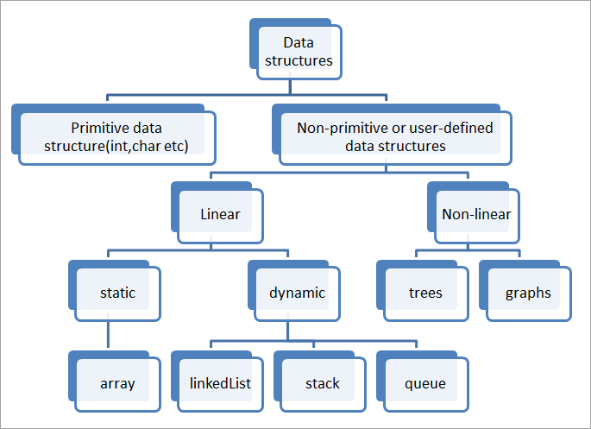

Slide 5
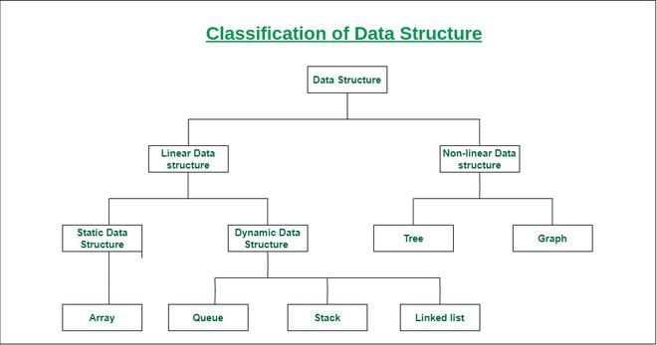

Slide 6
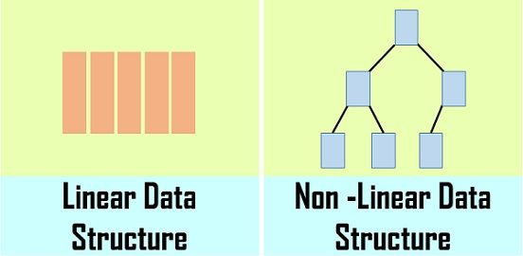
Linear vs Non-linear data structutre
Linear Data structure :
- organize data elements in a sequential manner
- element has a predecessor and a successor, except for the first and last elements.
Non-linear data structure :
-they have more complex relationships between elements.
-multiple predecessors and successors.

Slide 7
static vs dynamic data structures
A static data structure is fixed in size,
but dynamic structures can increase of decrease in size.

Slide 8
Abstract DataType(ADT)
defines the behavior of a data type without specifying the implementation details.
ADTs focus on what the data type does rather than how it is implemented.
Note : The process of providing only the essentials and hiding the details is known as abstraction.

Slide 9
Abstract DataType(ADT) [contd]
In computer science, an abstract data type (ADT) is a mathematical model for data types.

Slide 10
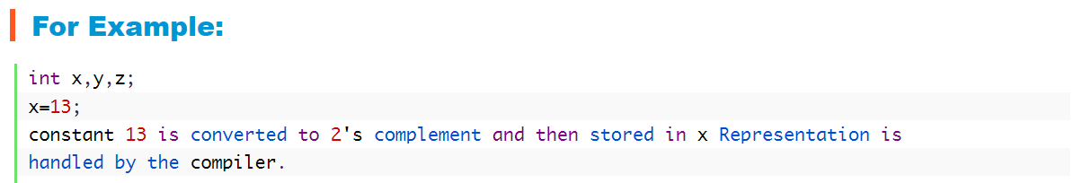
for example, (Not important for exam)
we have been using Primitive values like int, float, char data types only with the knowledge that these data type can operate and be performed on without any idea of how they are implemented.

Slide 11
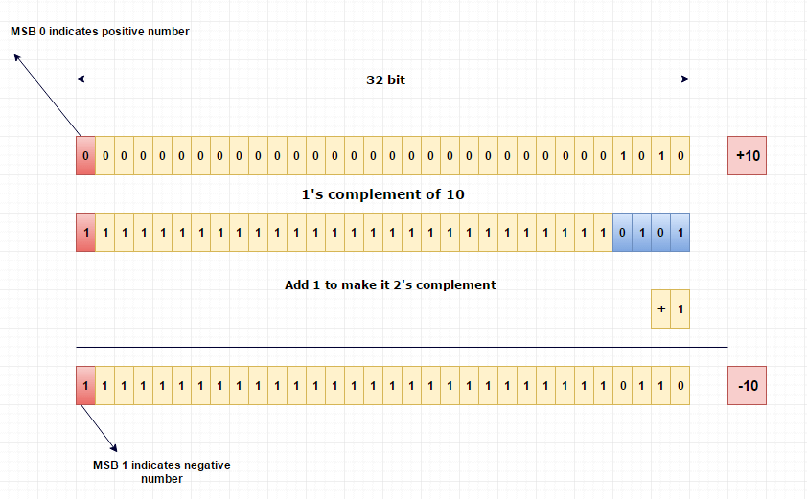
How computer store int? (Not important for exam)

Slide 12
For example
Abstract Data Type: Stack Operations:
Push: Adds an element to the top of the stack.
Pop: Removes and returns the top element of the stack.
Peek: Returns the top element of the stack without removing it.
IsEmpty: Checks if the stack is empty.
Size: Returns the number of elements in the stack.

Slide 13
Importance of data structure
Assignment

Slide 14
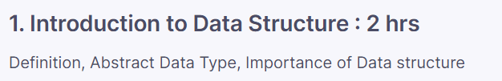
Syllabus

